Slide 1




Karmaveer Bhaurao Patil University’s
Yashavantrao Chavan Institute of Science,Satara
Mumbai Skies: Unpacking a Decade of Passenger and Freight Trends (2015-2024)
Project by
Rushikesh Dattatray Jadhav (M.Sc I Data Science)
Guided by
Prof. P.M. Bhosale (Coordinator Data Science)
Dated on 21/04/2025, Monday

Slide 2


Agenda
Analyzing Trends & Patterns: Passenger & Flights | 8
Further Analysis: Freight & Other | 9
Key Findings | 10
Conclusion: CSMIA's Strength as an International Hub | 11
Future Directions | 12
References | 13
Thank You | 14
Project : Short Brief | 1
Introduction: Mumbai's Gateway to the World | 2
Project Objectives | 3
My Approach: From Data to Insights | 4
Data Preparation | 5
Exploring the Data: Passenger & Flight Trends | 6
Exploring Freight Trends | 7

Slide 3
Project : Short Brief
Mumbai Skies: Unpacking a Decade of Passenger and Freight Trends (2015-2024):
A comprehensive analysis of the significant trends over a pivotal decade for Mumbai's aviation sector.

Slide 4
Introduction: Mumbai's Gateway to the World
Mumbai: An International Hub: Mumbai has emerged as a central nexus for international air travel, connecting India with key global destinations.
CSMIA's Role: Chhatrapati Shivaji Maharaj International Airport stands as a crucial facilitator of global connectivity, enhancing trade and tourism.
Study Aim: Analyze International Air Travel: The research focuses on quantifying and understanding the trends of air transport at CSMIA over the last decade.
Focus Areas: Passenger and Cargo Trends: Examines fluctuations in passenger traffic, the frequency of operations, and the expansion of flight routes in this critical timeframe.
Influencing Factors: Economic & Global Trends: Investigates the impact of tourism growth, economic conditions, airport initiatives, and global events, notably the COVID-19 pandemic.
Goal: Uncover Insights for Stakeholders: Aims to provide actionable insights that will guide strategic decision-making for industry stakeholders.

Slide 5
Analyze Air Travel Trends
Utilize time series analysis to capture and interpret fluctuations in international traffic over the last decade.
Project Objectives
Examine Passenger Movement
Explore the trends in passenger flow and outline the frequency of departures and arrivals across various destinations.
Present Insights with Statistical Models
Leverage robust statistical techniques and data visualizations to articulate key findings and trends effectively.

Slide 6







Systematic Research Methodology: analysis.
My Approach:
From Data to Insights
A structured approach to ensure robust insights through defined methodologies in data
Key Stages:
Data Collection to Visualization:
The project encompasses a series of steps: from data collection, through preprocessing, to exploratory data analysis and visualization.

Slide 7
Data Sources
Utilized resources like the Mumbai Aviation Traffic Data Portal and DGCA website for comprehensive data acquisition.
Comprehensive Datasets
Aggregated robust datasets encompassing passenger counts, flight schedules, and destination details from 2015 to 2024.
Data Preparation
Preprocessing Steps
Executed data aggregation, handled missing values, standardized formats, and identified outliers for thorough analysis.
Final Dataset
Consolidated to 1,812 records across 9 columns, providing a comprehensive overview for analysis.

Slide 8

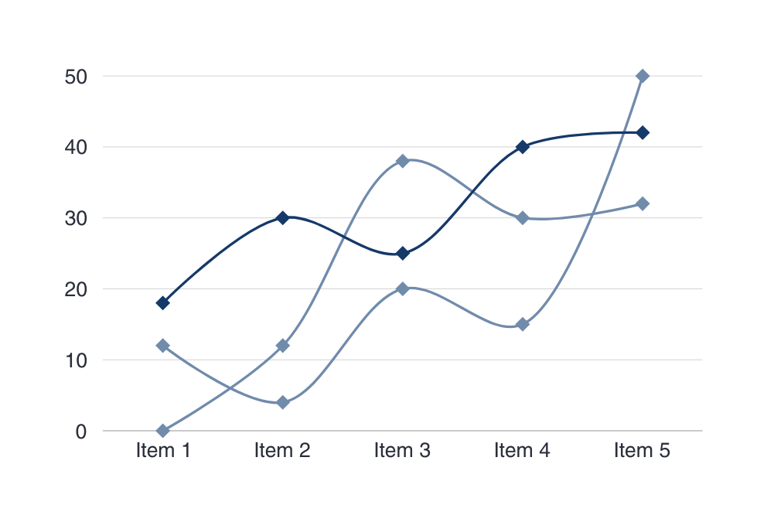
Exploring the Data: Passenger & Flight Trends
INITIAL TREND ANALYSIS
Conducted preliminary analyses to discover underlying trends and patterns in the data.

Slide 9

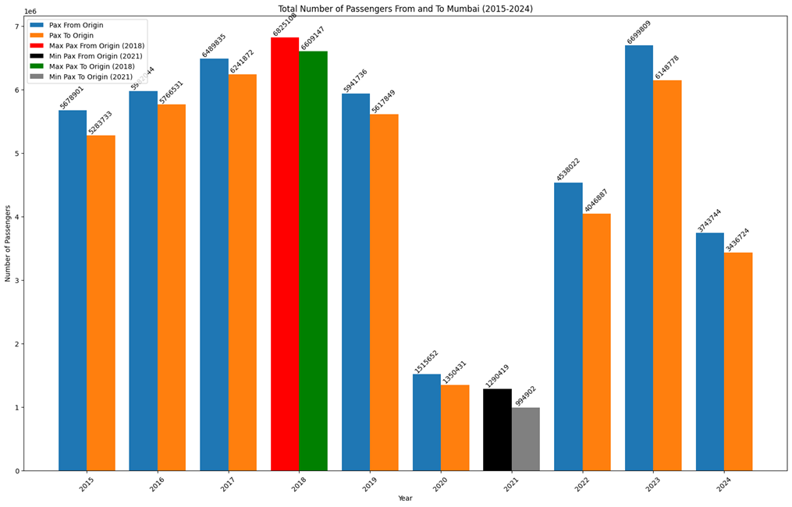
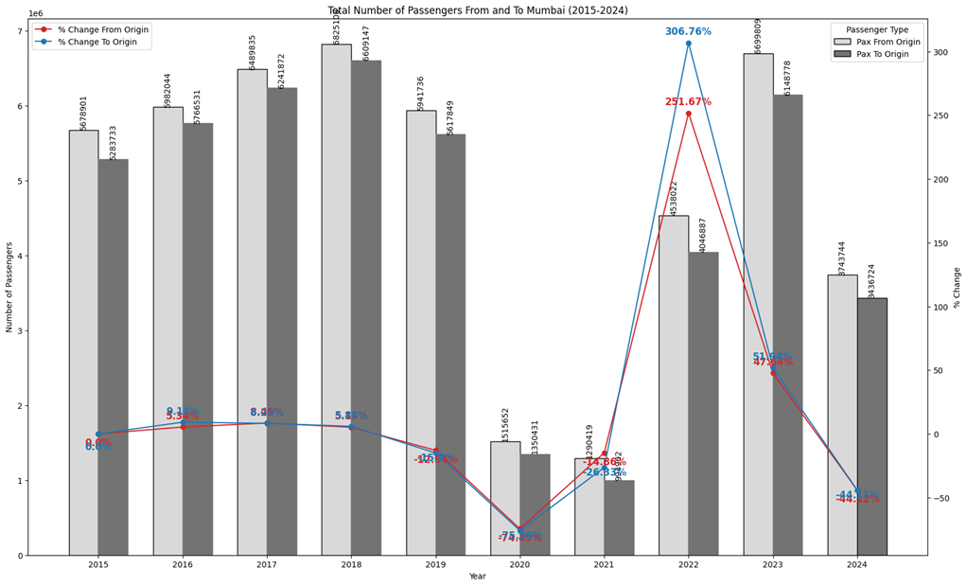
PASSENGER TRAFFIC TRENDS (2015-2024)
Detailed insights on total passengers and the segmented analysis of pre-pandemic growth, COVID-19 impacts, and the recovery phase.

Slide 10
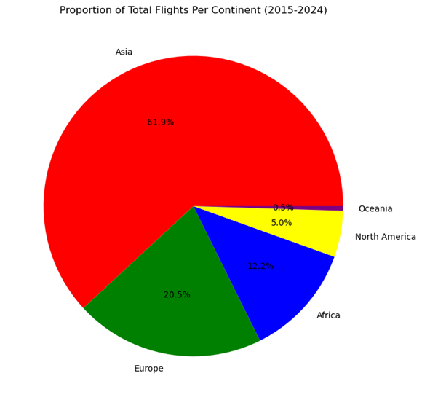
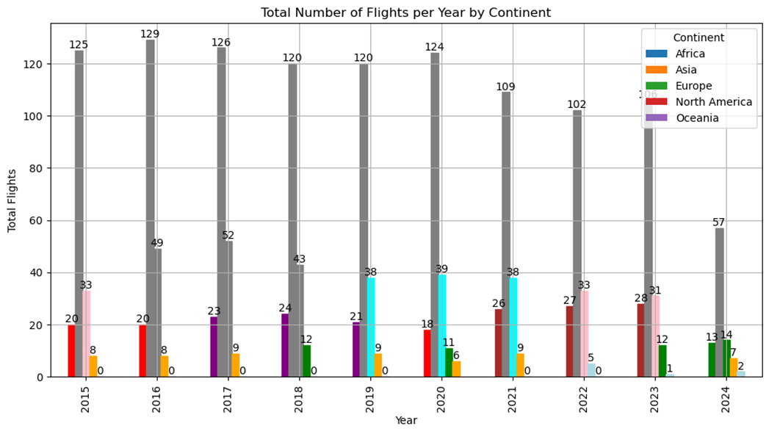
FLIGHT FREQUENCY ANALYSIS
Analyzing the distribution of flight frequencies on a year-by-year and continental basis to identify changes and growth.

Slide 11
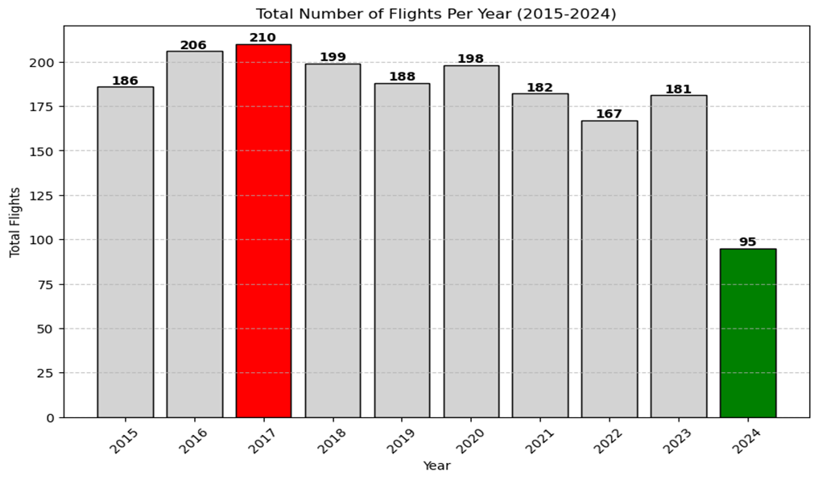
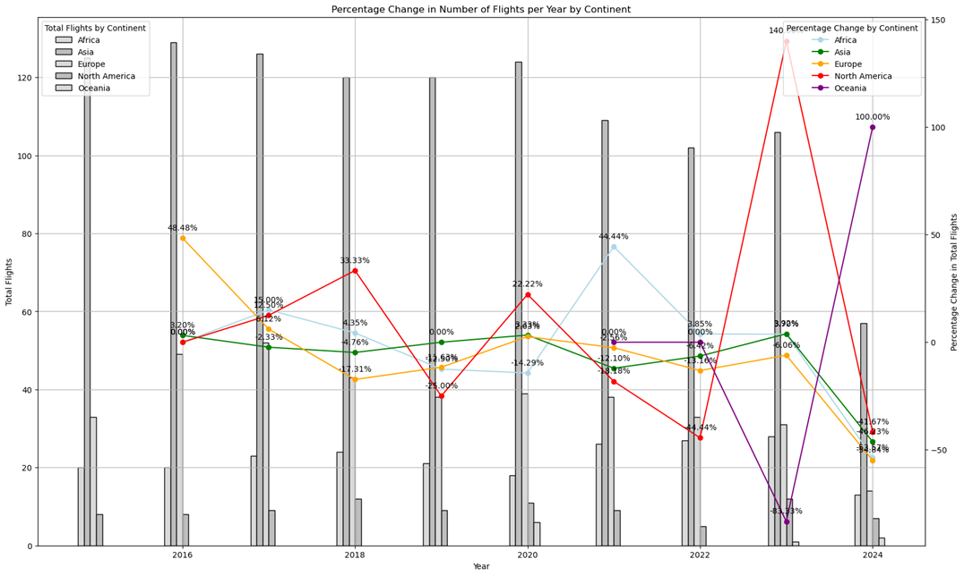
FLIGHT FREQUENCY ANALYSIS
Analyzing the distribution of flight frequencies on a year-by-year and continental basis to identify changes and growth.

Slide 12
Exploring Freight Trends
Briefly elaborate on what you want to discuss.
CARGO MOVEMENT ANALYSIS
Delve into both outbound and inbound cargo trends to understand the dynamics of freight movement within the airport.
FREIGHT MOVEMENT (2015-2024)
A thorough examination of changes in outbound and inbound cargo flows and their implications on the economy.
TIME SERIES PLOT INCLUSION
Visual representation of the trends achieved from the time series data analysis around freight movement through the years.

Slide 13
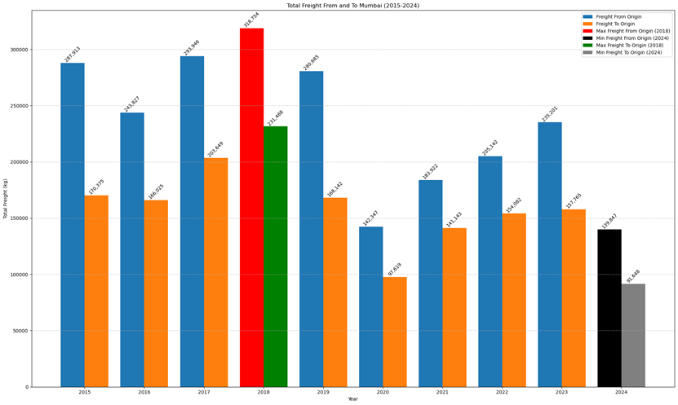
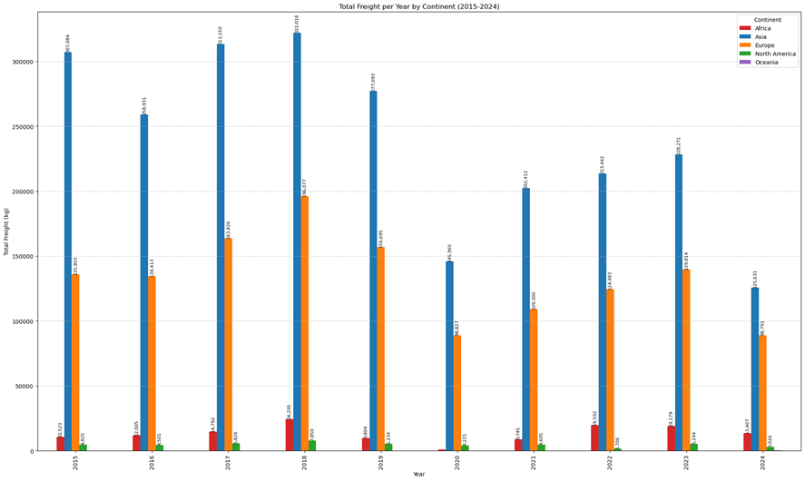
Exploring Freight Trends

Slide 14

Further Analysis: Freight & Other
Freight Distribution Insights
FREIGHT DISTRIBUTION INSIGHTS
TInvestigate patterns in freight distribution, revealing peak years for cargo movement both inbound and outbound.
Seasonal Variations
SEASONAL VARIATIONS
Identify and analyze peak quarters as well as periods of minimal activity that affect freight operations.
Airline Market Share
AIRLINE MARKET SHARE
Evaluate the market share of leading airlines operating at CSMIA and how it reflects competitive dynamics

Slide 15
Key Findings
1
2
3
Passenger Recovery
Flight Distribution Dominance
Cargo Resilience
Insights reveal that 2023 traffic levels have not only recovered but surpassed pre-pandemic metrics.
Analysis demonstrates that Asia continues to dominate in terms of flight traffic relative to Mumbai.
Freight volumes show substantial growth following 2021, indicating strong market recovery and resiliency.

Slide 16
Conclusion
CSMIA's Strength as an International Hub
Mumbai CSMIA: Premier International Hub:
The airport has consolidated its status, reaffirming its role as India’s leading international aviation gateway.
Contributing Factors to Success:
Key elements include strategic route expansions, significant infrastructure investments, and resilience in recovery efforts post-COVID.

Slide 17
Real-Time Analytics
Emphasize the need for integrating live flight data APIs to facilitate instantaneous decision-making capabilities.
Future Directions
Sustainability Metrics
Highlight the importance of analyzing carbon emissions to align aviation practices with environmental objectives.
Economic Impact Studies
Future research should explore correlations between passenger and freight growth with tourism revenue generation.

Slide 18

Mumbai Aviation Traffic Data Portal
Utilized for obtaining critical traffic datasets relevant to the study.
References
DGCA Annual Reports
Consistent reference for industry standards and patterns in civil aviation
Python Libraries
Utilized analytical tools such as Pandas, Matplotlib, Seaborn, and Plotly for data analysis and visualization.

Slide 19



Connect with Me.
Email
rushiraj070@yahoo.com
Social Media
@LinkedIn,
Give a Call
7720043793

Slide 20











Thank You Page
Thank you for your time
Questions?

